Slide 1


Your Sandbox isn’t a pathway to production, it’s a pathway to “CLICK, CLICK, OOPS”

Slide 2

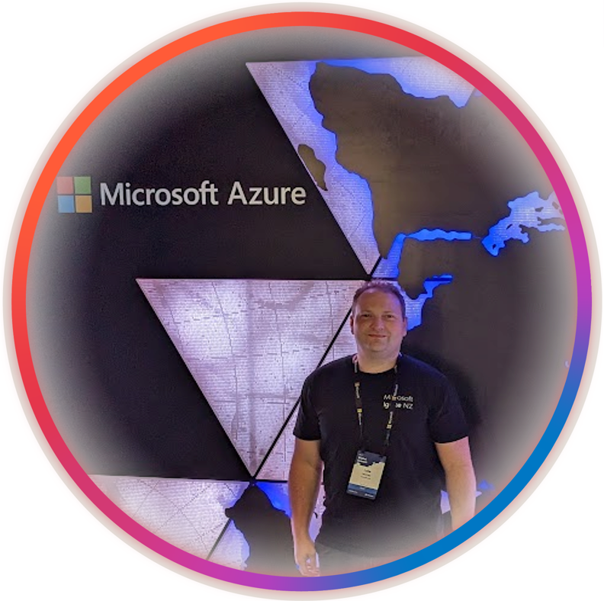
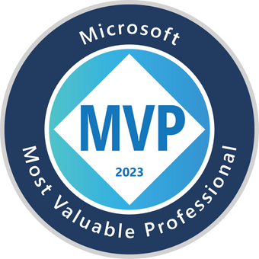


So, who am I?
My name is Luke Murray
He/Him
Senior Consultant in Hamilton, New Zealand.
Feel free to reach out on Social Media, if you need any help: https://linktr.ee/lukemurray
Introduction
Azure Cloud
Commanders

Slide 3
Today, we'll be discussing Azure Landing Zones, a fundamental architectural approach to set up an environment for successful Azure cloud deployments.
Let's delve into how we can design sandbox environments effectively!
Agenda

Slide 4
Leave questions till the end.
Feel free to reach out on Social media

Slide 5
First, WHY do I care?

Slide 6


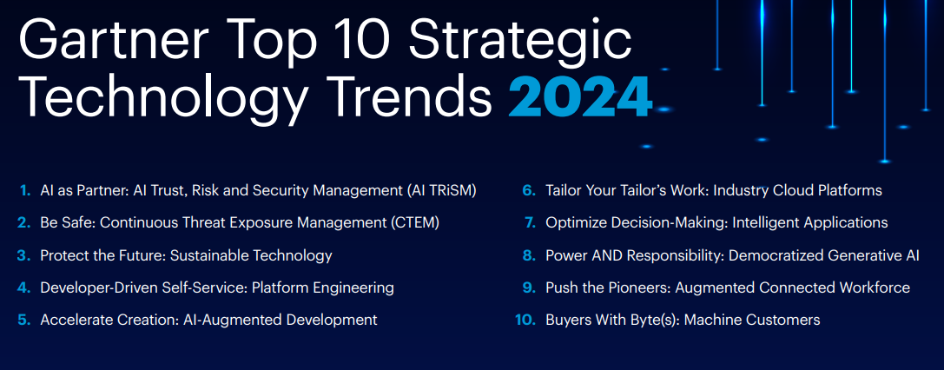

Teams
Business
Gartner Top 10 Strategic Technology Trends 2024
Gartner – Strategic Technology Trends
Platforms

Slide 7
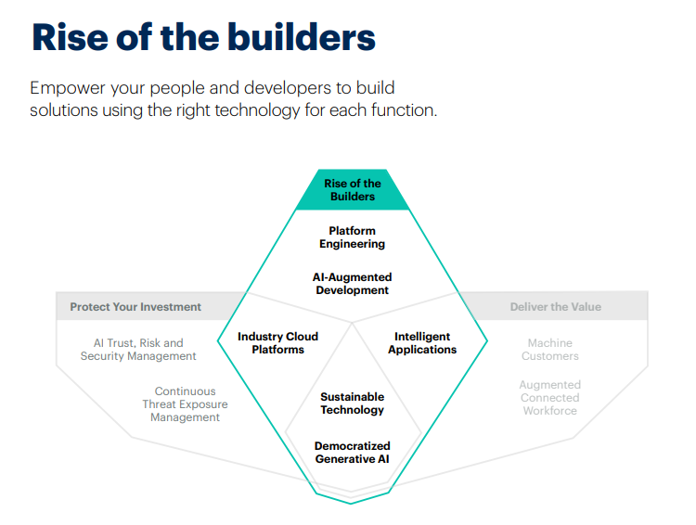
Rise of the builders
Teams
Business
BP has enabled its employees to create their own solutions with limited involvement from IT.
BP developed a broad portfolio of digital platforms to match its users’ capabilities and needs.
It automated security testing, component scanning and licensing, and release automation
Gartner – Strategic Technology Trends
Platforms

Slide 8
Teams
Business
So, what is Platform Engineering?
Gartner – Strategic Technology Trends
The discipline of building and operating self-service internal platforms — each platform is a layer, created and maintained by a dedicated product team, designed to support the needs of its users by interfacing with tools and processes
Platforms

Slide 9
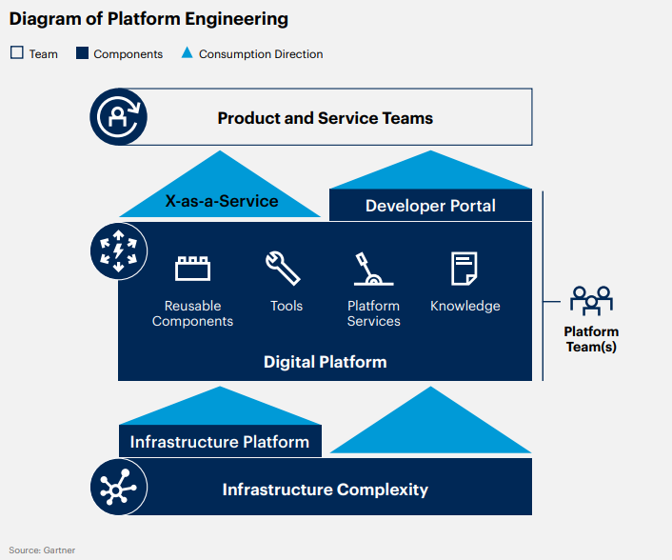
This practice optimizes the developer experience and accelerates delivery of business value
It reduces cognitive load through improvement of the developer experience and productivity
Developers’ abilities to independently run, manage and develop their applications is improved, while ensuring reliability and security.
Key talent retention is also improved.
Platform Engineering
By 2026, 80% of software engineering organizations will establish platform teams as internal providers of reusable services, components and tools for application delivery.

Slide 10

KEEP
CALM
AND
PUT IT IN AZURE
How can Microsoft Azure help?

Slide 11

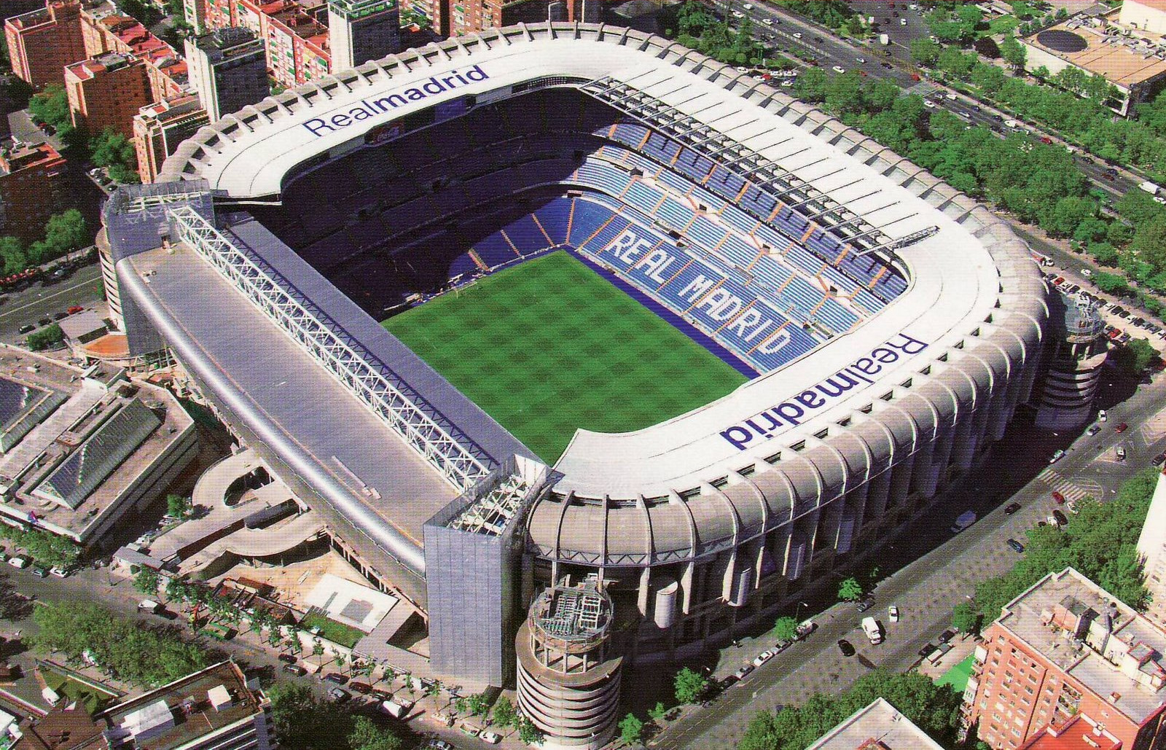

What are you going to build?
What is an Azure Landing Zone?
Azure Landing Zone
A house
A stadium
A city ship
Notes:
Azure Landing Zones are a set of guidelines, best practices, and resources to help organizations set up an environment for successful cloud adoption. They provide a foundation for secure, scalable, and compliant cloud solutions

Slide 12
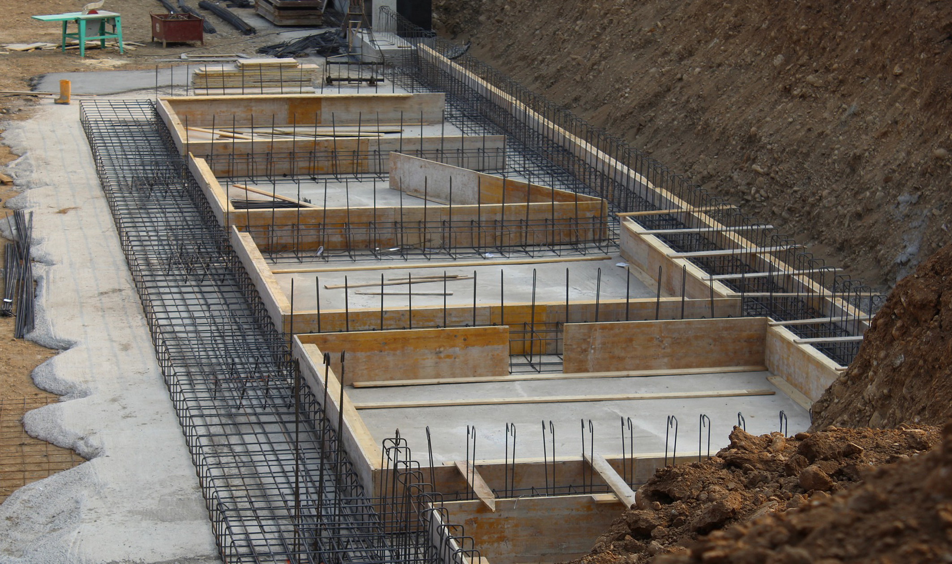
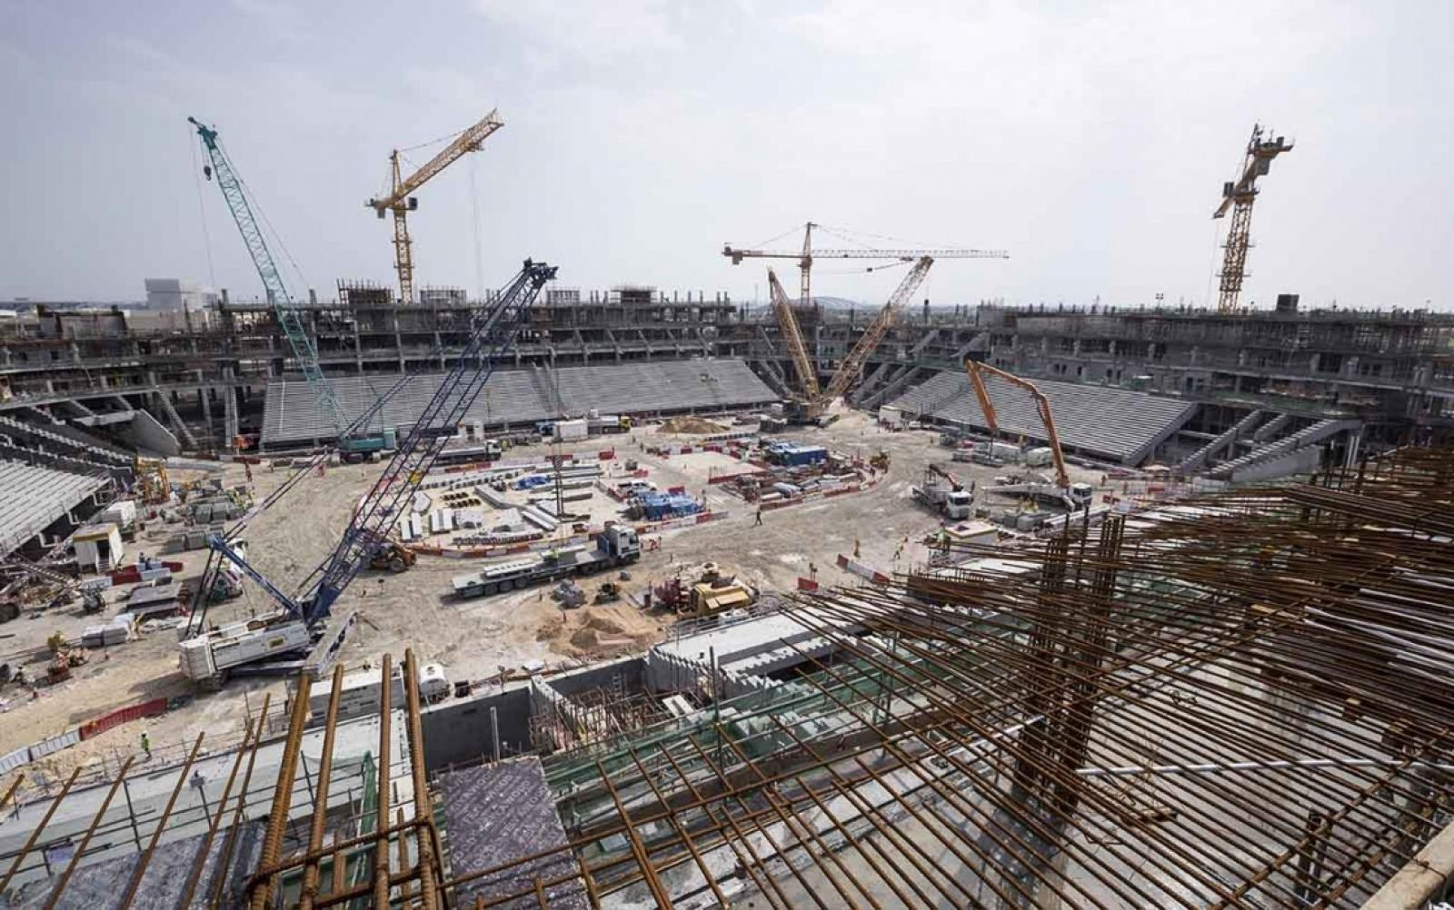

All foundations are NOT created equal
What is an Azure Landing Zone?
Azure Landing Zone
A house
A stadium
A city ship

Slide 13

Identity
Enterprise Enrollment
Resource Organization
Azure Landing Zone
Design Areas
Azure Landing Zone
Network Topology & Connectivity
Business Continuity & Disaster Recovery
Governance disciplines
Deployment options
Operations baseline

Slide 14
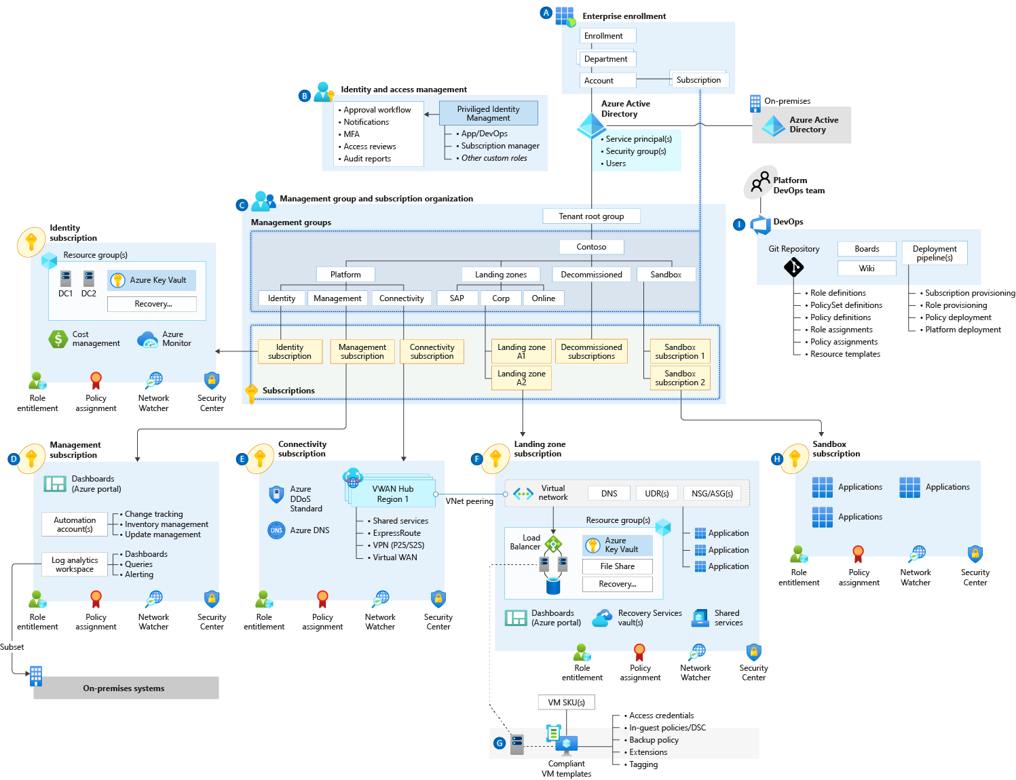
Enterprise Scale Reference Architecture
(Foundational)

Slide 15
KEEP
CALM
AND
PUT IT IN AZURE
Sandbox

Slide 16
A sandbox is ideal for accelerating projects. After you deploy your sandbox environment, you can add services and capabilities. You can use the sandbox for activities like:
• Self-learning
• Hackathons
• Testing
• Development
Azure Landing Zone - Sandbox

Slide 17
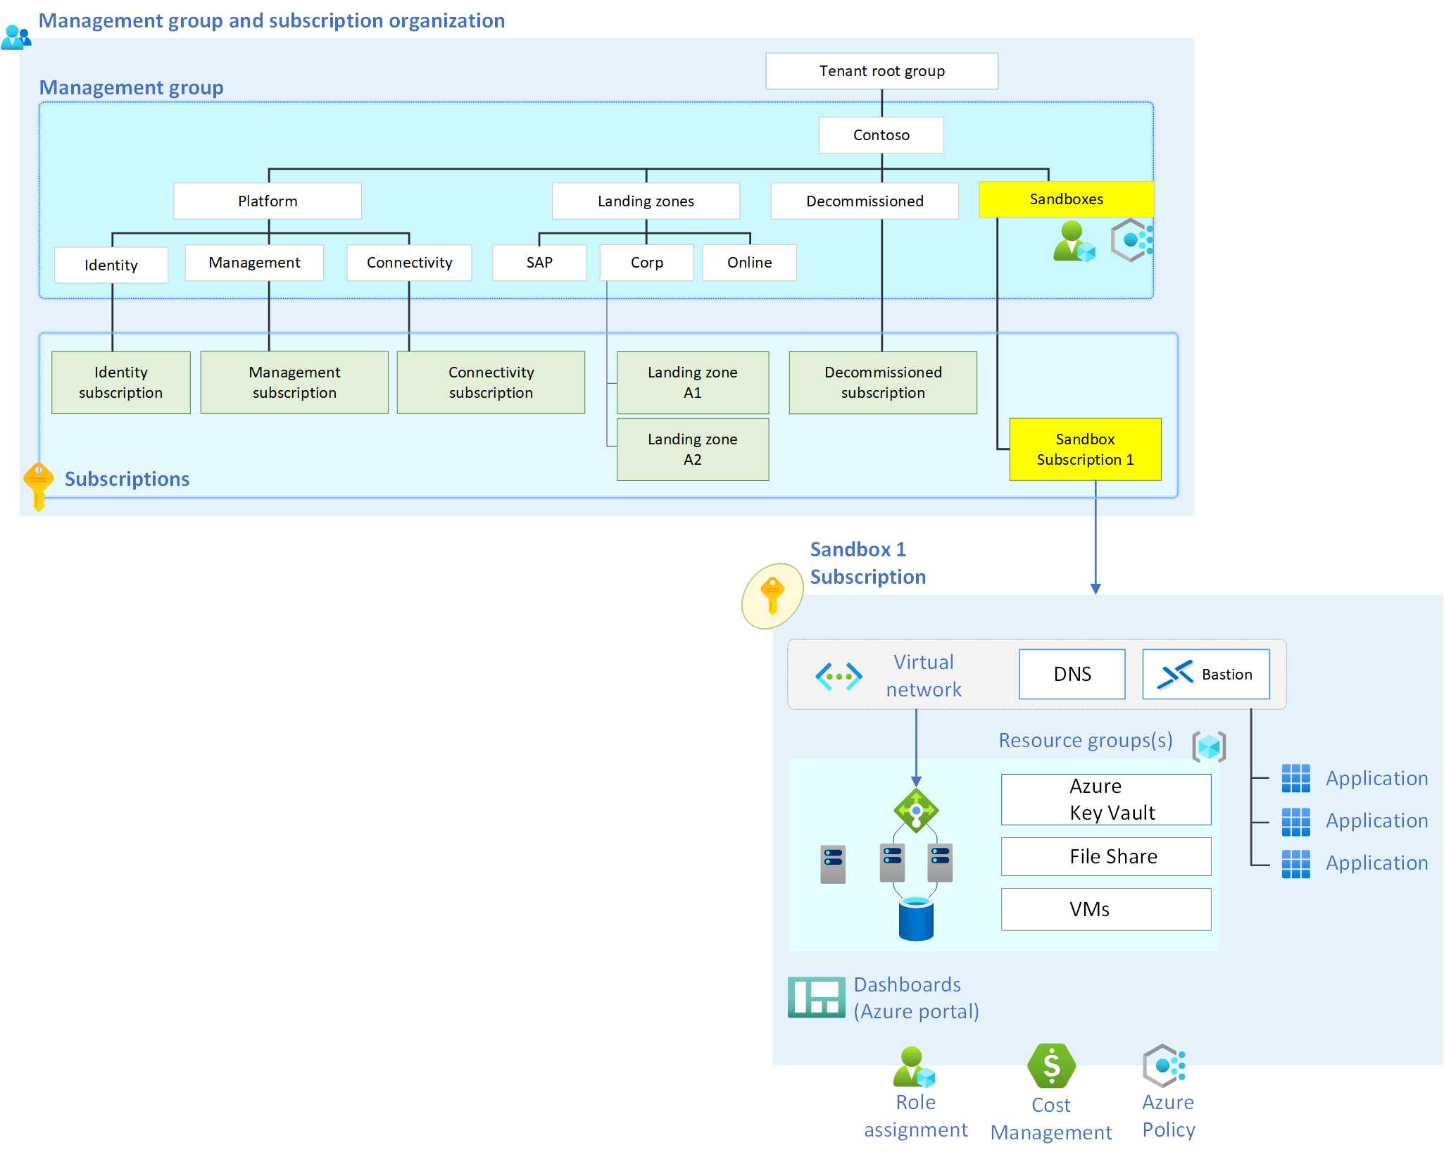
Off to the side: A sandbox usually contains:
Data isolation
Network security (segregated)
Identity and access controls
Compliance and regulatory considerations

Slide 18
Azure Landing Zone - Sandbox
Policies to restrict locations
Sandbox Tradeoffs
Over extensive block lists
Trying to build entire platform at once
Notes:
Personal involves the use of Visual Studio Enterprise subscriptions; Visual Studio Enterprise accounts can be used to grant Azure credits for learning and development purposes and how to apply them to the sandbox environments.
The unmanaged sandbox is a low-cost and low-risk environment that allows users to experiment with Azure services and learn new skills without affecting the production environment or incurring unexpected costs.

Slide 19
Personal
Azure Landing Zone - Sandbox
Unmanaged
Sandbox types
Lightly managed
Managed
Notes:
Personal involves the use of Visual Studio Enterprise subscriptions; Visual Studio Enterprise accounts can be used to grant Azure credits for learning and development purposes and how to apply them to the sandbox environments.
The unmanaged sandbox is a low-cost and low-risk environment that allows users to experiment with Azure services and learn new skills without affecting the production environment or incurring unexpected costs.

Slide 20
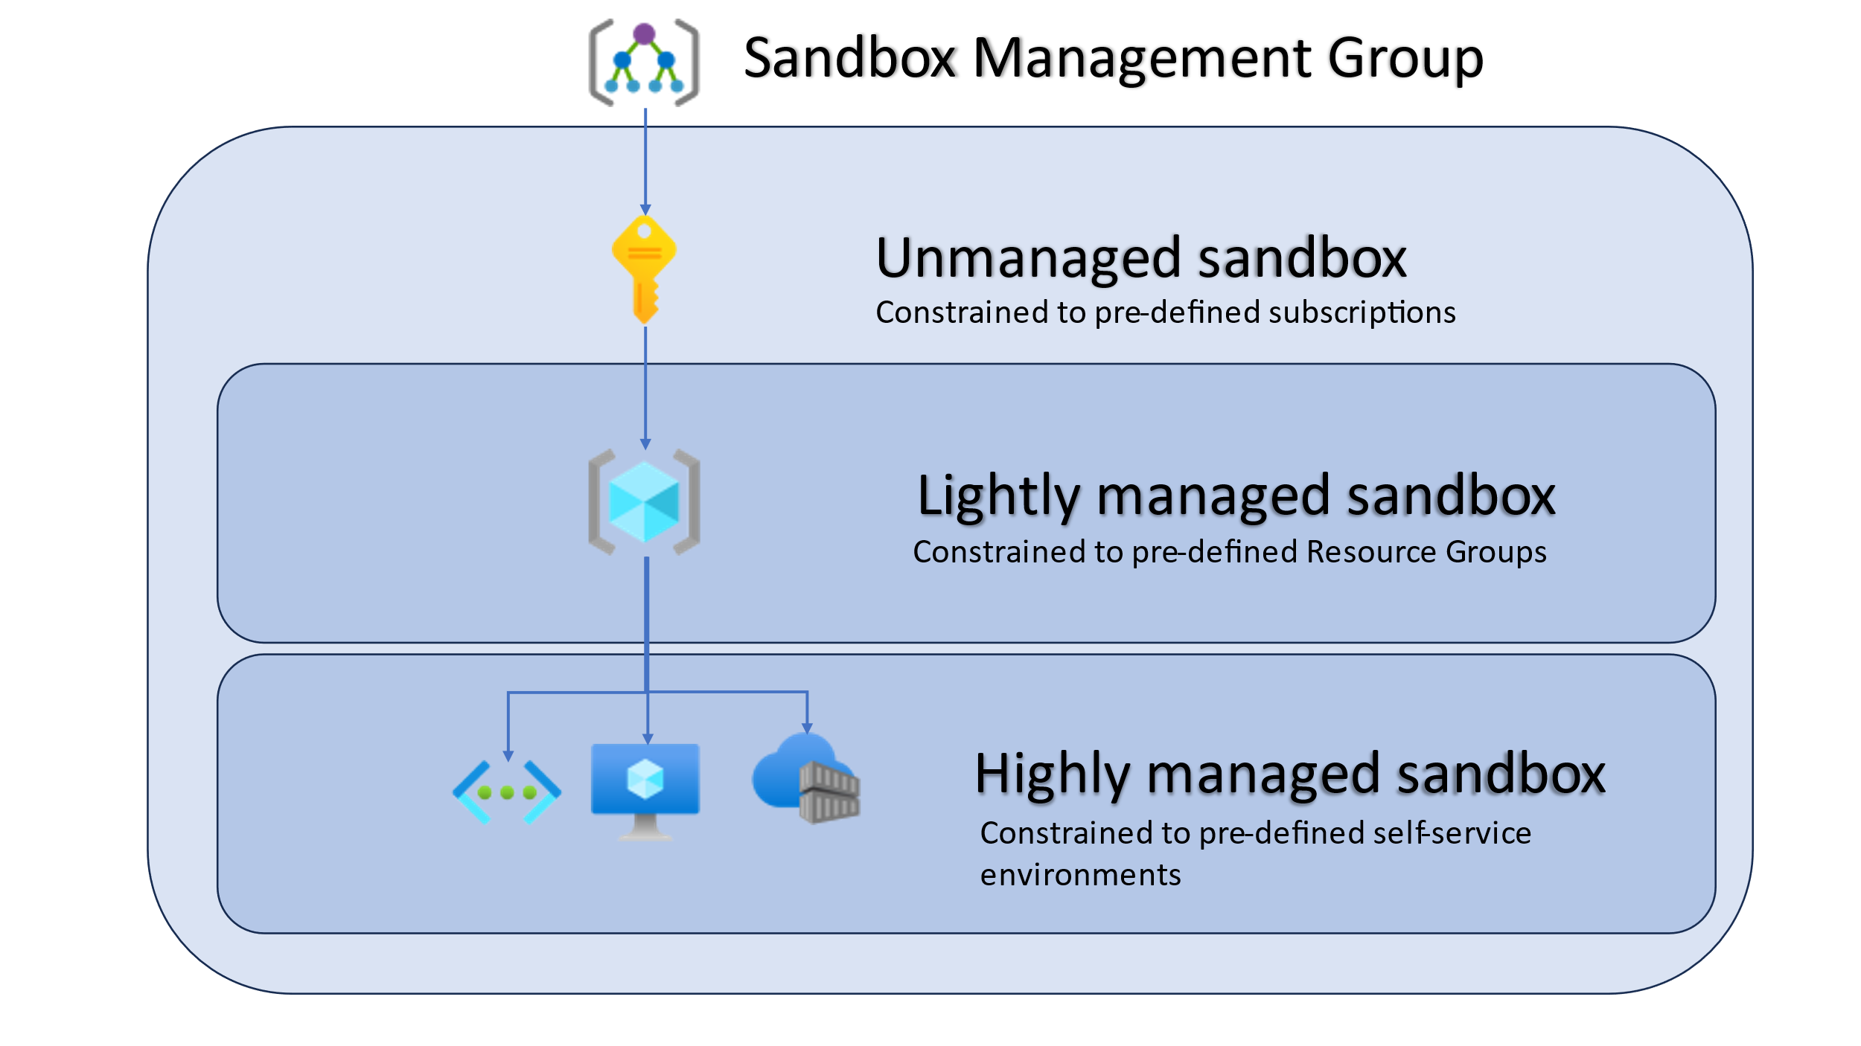
Sandbox types
Notes:
So, when do you use what type?

Slide 21
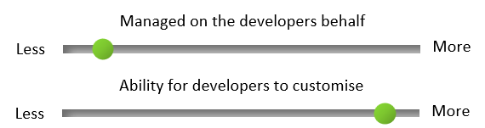
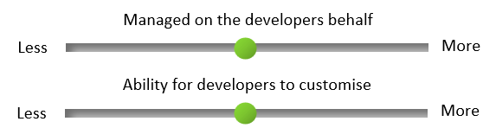
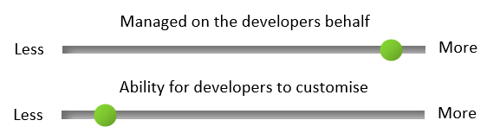
Unmanaged
Azure Landing Zone - Sandbox
Sandbox types
Lightly managed
Managed

Slide 22
Azure Landing Zone - Sandbox
The main difference is that Managed sandboxes have pre-determined services that can be deployed as needed, useful for testing the same set of services repeatedly.
Lightly managed sandboxes are useful when you have a lot of individuals wanting a specific regulated Resource Group to stand up resources into.
In contrast, the Unmanaged sandbox is more open and less restrictive, ideal for learning and trying new technologies for a small to large team.
Sandbox types
Notes:
So, when do you use what type?

Slide 23
Purpose
Scope
Cost
Access
Lifecycle
Management
Governance
Security
Monitoring
Integration
Migration
Azure Landing Zone - Sandbox
Sandbox type decisions
Notes:
So, when do you use what type?

Slide 24
KEEP
CALM
AND
PUT IT IN AZURE
Azure Open AI and Azure Sandbox

Slide 25

Goals to achieve
1. | Deliver high-quality and robust machine learning solutions that can enhance the customer satisfaction and loyalty, as well as increase the revenue and profitability of the company.
2. | Learn the latest and most advanced techniques and methods in the field of artificial intelligence, such as natural language processing, computer vision, and deep learning, to create innovative and cutting-edge models.
3. | To collaborate and learn from other data scientists and experts in the field, both within and outside his company, to improve his knowledge.
4. | Self management and accountability of cost management and access to the environment, for Data/AI projects across multiple responsible team members.
Samuel
Quotes – what persona says
Azure OpenAI is a game-changer for data scientists. It allows me to access and integrate the most advanced and versatile models for natural language processing and computer vision, such as GPT-3, DALL-E, and CLIP, and to create and customize my own models using the easy and intuitive tools and interfaces, such as Codex, Studio, and Playground.
Data Scientist
Core role What are their key responsibilities or tasks?
Samuel is a data scientist who works for a large e-commerce company. He is responsible for developing and deploying machine learning models that can optimize the customer experience, such as product recommendation, personalization, and sentiment analysis Samuel job success depends on the accuracy, efficiency, and scalability of his machine learning models, as well as the impact and value they can generate for the customers and the company.
Azure Landing Zone - AI
Scenario
Pains to avoid What are the top 3 things they are trying to avoid in their job role, in relation to yours or a similar business solution?
1. | Poor performance or errors in his models that can affect the quality and reliability of his solutions
2. | Ethical, fair, or transparent issues in his models that can cause harm or bias to the customers or the company
3. | Lack of alignment or communication with the best practices and standards in the field
Key relationships Who are they closely associated with in their professional ecosystem?
Internal: Her peers, managers, and other teams in his company that are involved in the development, deployment, and evaluation of the machine learning solutions. External: The customers and users who benefit from the machine learning solutions, and the industry leaders and experts who provide feedback, recognition, and guidance for the machine learning solutions.

Slide 26
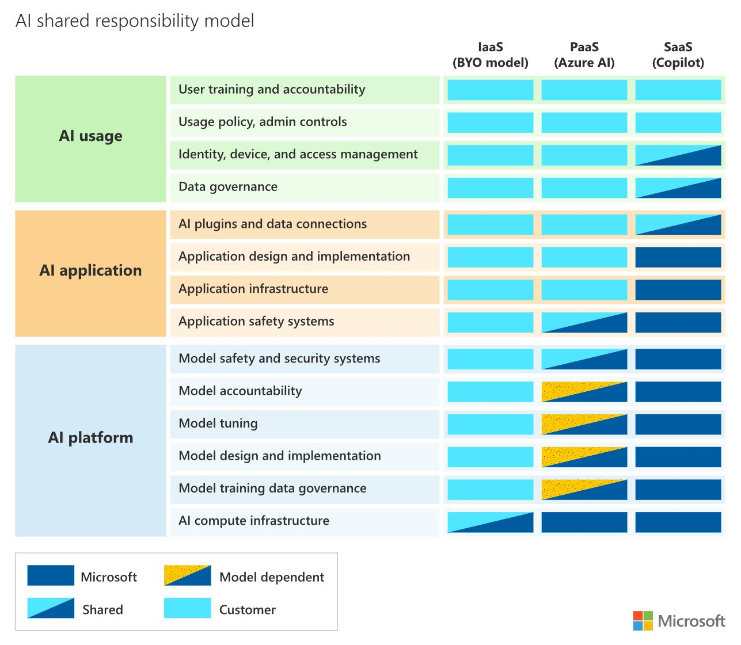

Slide 27
Learn new skills
Evaluation of cutting-edge technology
Azure Landing Zone - Sandbox
Work with team members, both external and internal
Unmanaged
Isolated from Production
Accepted accountability of cost and access for team members.

Slide 28
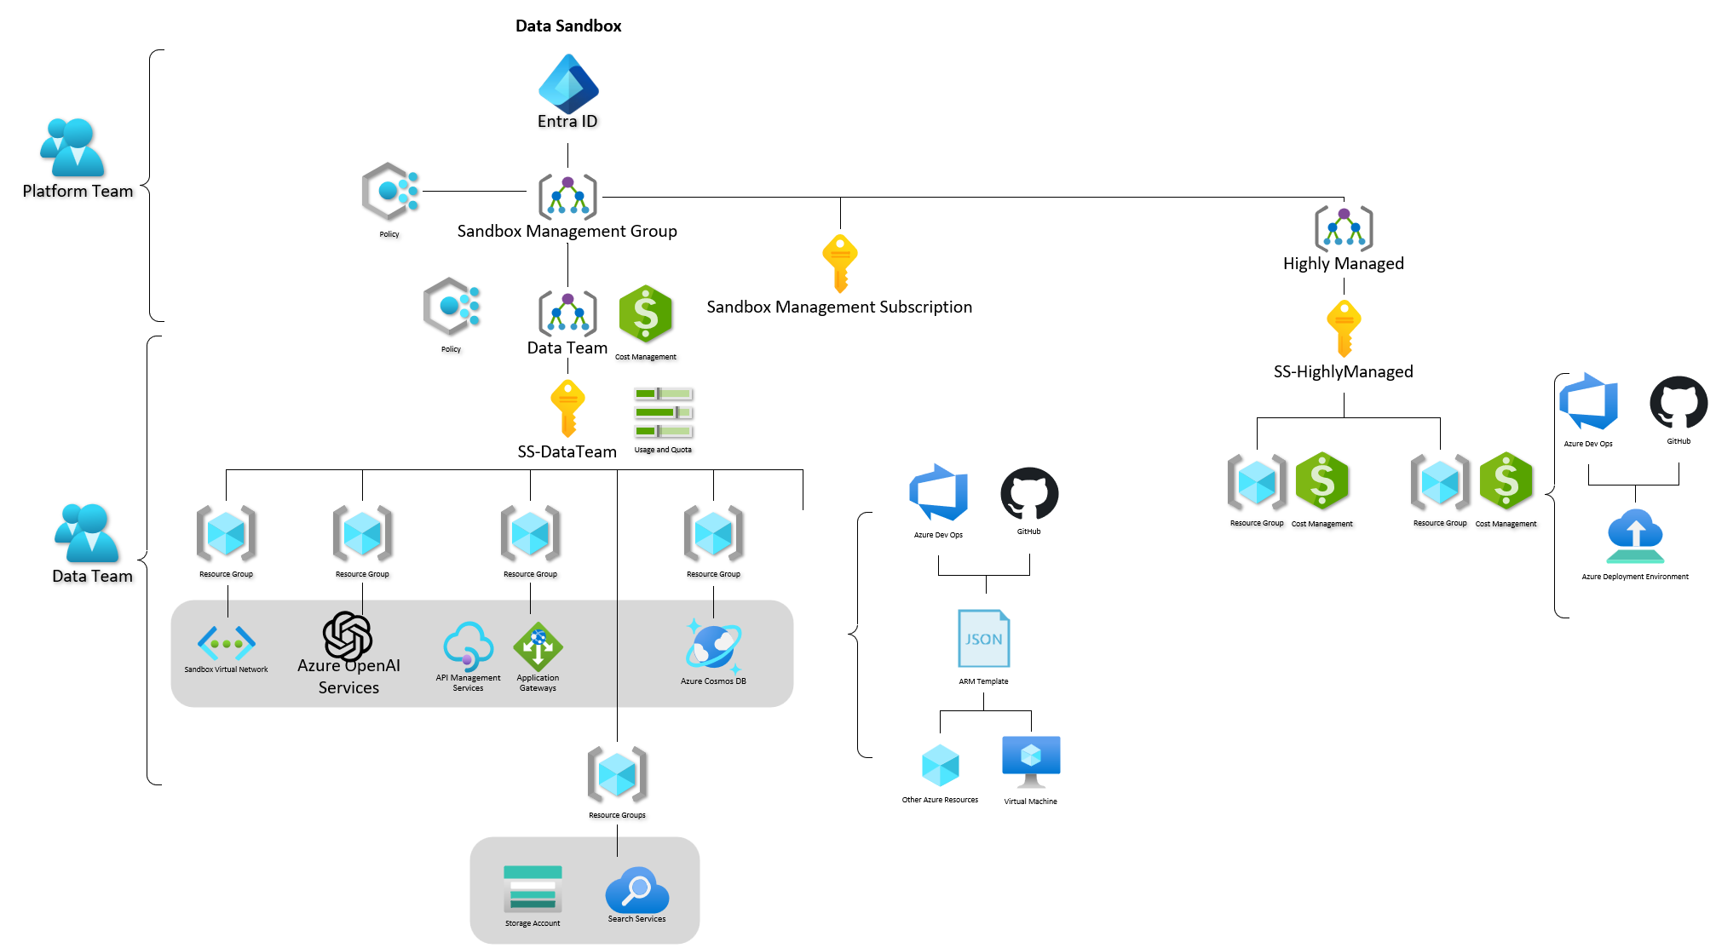
Azure Landing Zone - Sandbox

Slide 29
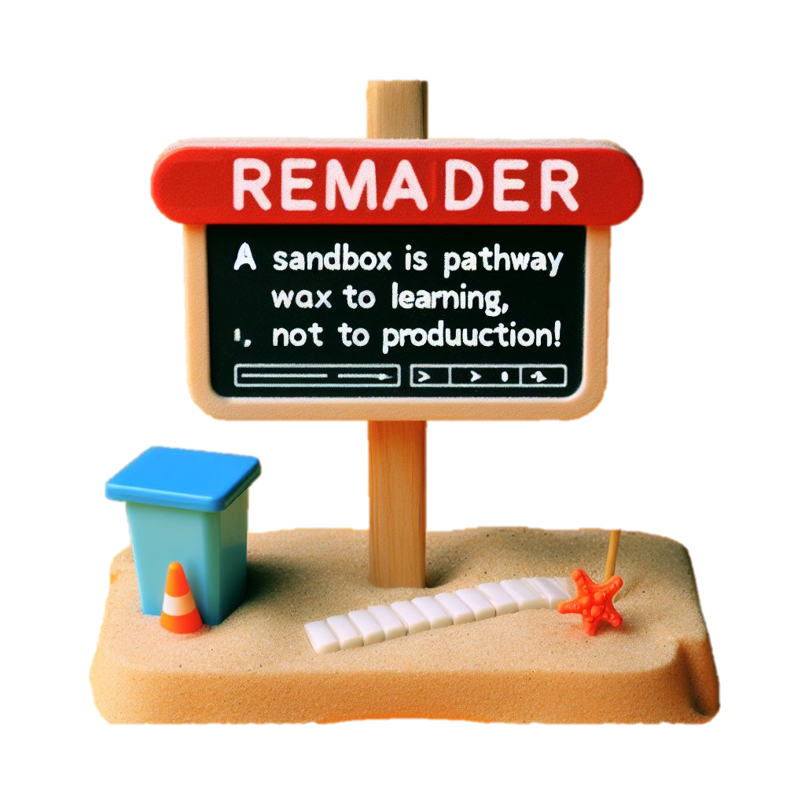
Pathway to Production
Dev/Test
Identify and document the requirements and specifications of the product after your learning
Security considerations (RBAC, Access, CISO review)
Ensure that the data, code, models, and outputs are suitable for Production, Change
Deploy the production using CI/CD
Monitor and manage
Test and debug

Slide 30
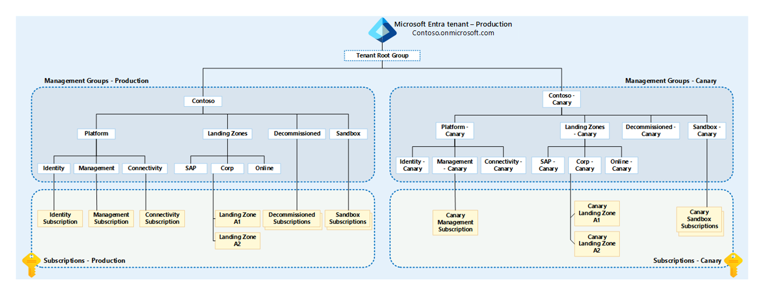
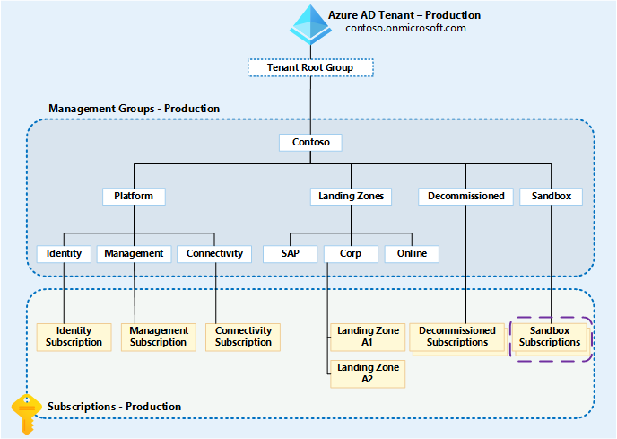
As the diagram shows, the entire Azure landing zones production environment management group hierarchy is duplicated under the Tenant Root Group. The canary name is appended to the management group display names and IDs. +
https://aka.ms/alz/canary
https://aka.ms/alz/canary
Notes:
The canary environment management group hierarchy is then used to simplify testing of the following resource types:
Management groups
Subscription placement
RBAC
Roles (built-in and custom)
Assignments
Azure Policy
Definitions (built-in and custom)
Initiatives, also known as set definitions
Assignments

Slide 31
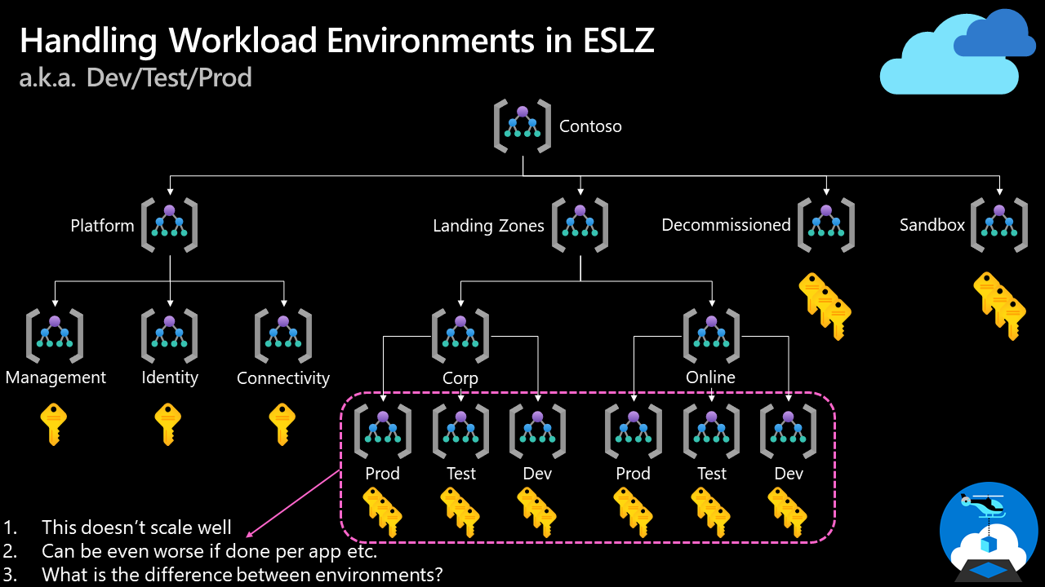

Slide 32
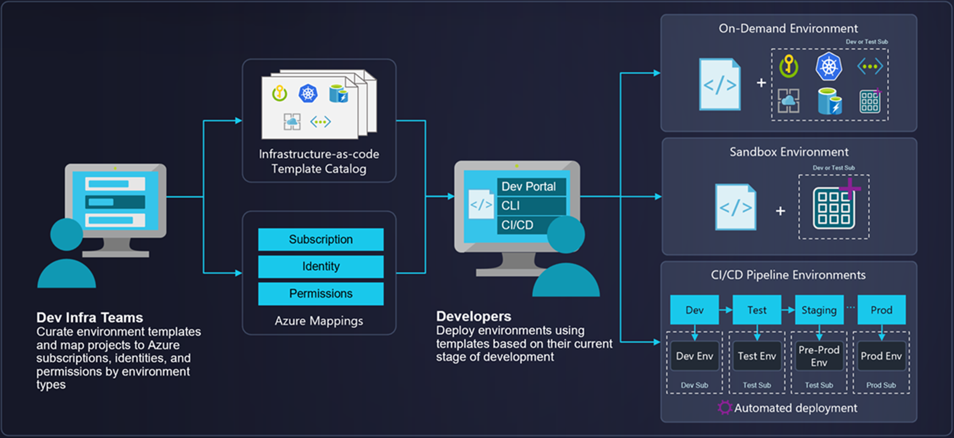
Azure Landing Zone – Highly Managed
Azure
Deployment Environments
Notes:
ADE currently supports ARM templates publicly and Terraform support is in private preview. In the near future, will support other IaC tools such as Bicep, Pulumi, etc.

Slide 33
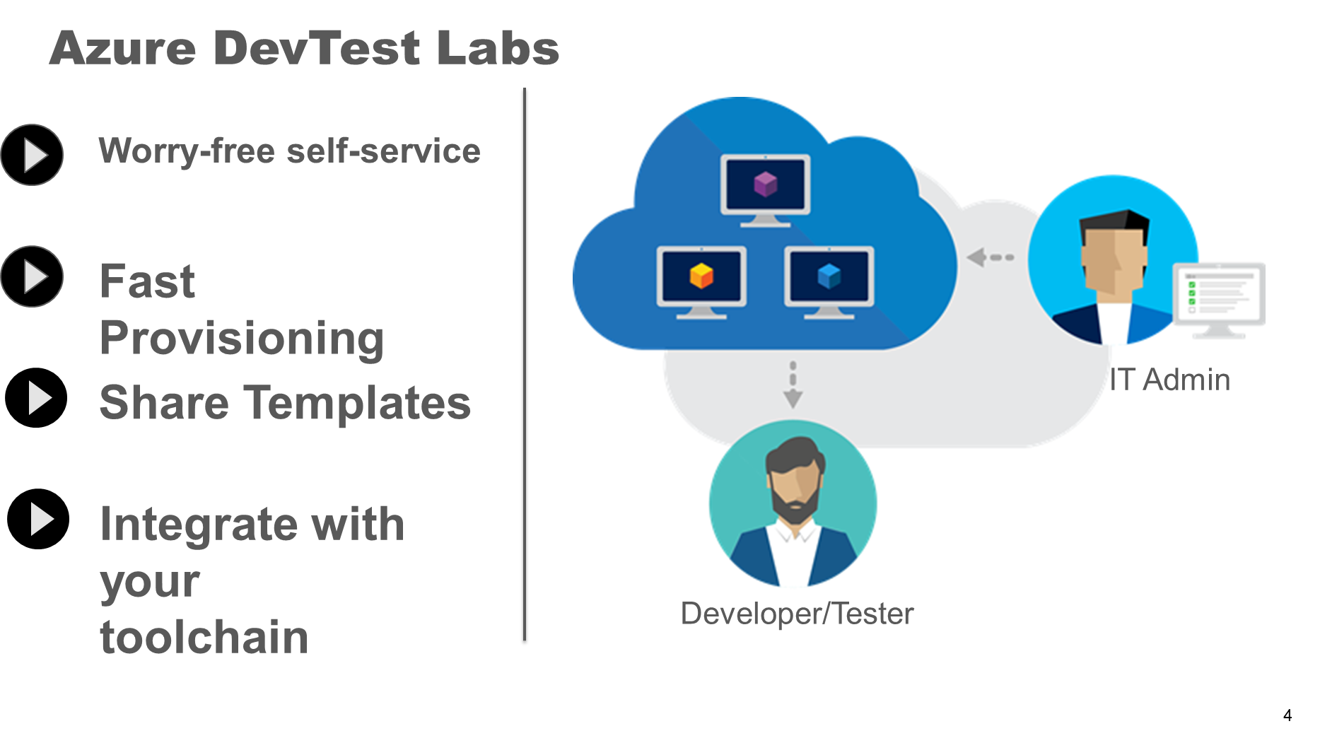
Azure Landing Zone – Lightly Managed
Azure
DevTest Labs
(VM orientated, student training, resources bound to one subscription)

Slide 34
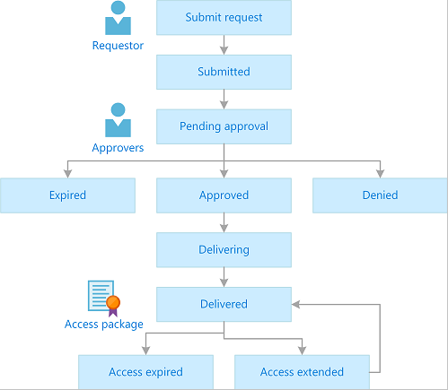
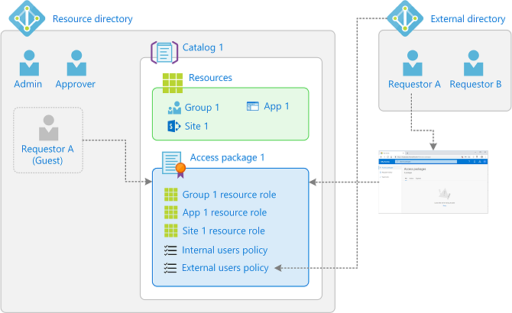
Azure Landing Zones
Entra ID
Access Packages
(Requires Microsoft Entra ID Governance licenses)
Notes:
ADE currently supports ARM templates publicly and Terraform support is in private preview. In the near future, will support other IaC tools such as Bicep, Pulumi, etc.

Slide 35
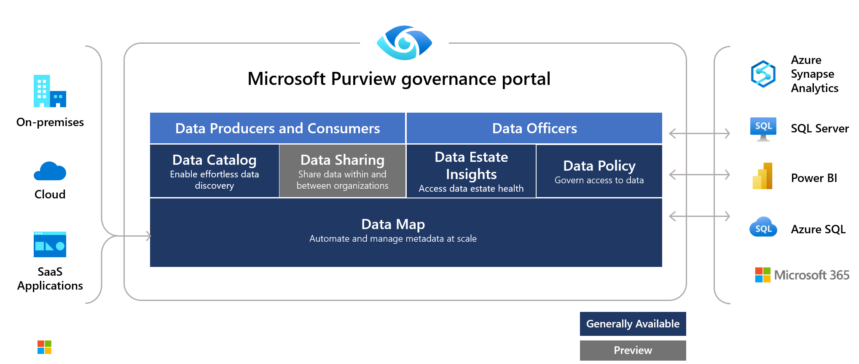
Azure Landing Zones
Microsoft Purview
Information protection for sandbox environments. Purview can send alerts if a user adds data that the organization labels as sensitive to sandbox environments.
Notes:
ADE currently supports ARM templates publicly and Terraform support is in private preview. In the near future, will support other IaC tools such as Bicep, Pulumi, etc.

Slide 36
Interested in further information?
Gartner Top 10 Strategic Technology Trends for 2024
Azure Sandbox (Azure Architecture Center)
Microsoft Azure - Cloud Adoption Framework
Azure subscription and service limits, quotas, and constraints
Azure Deployment Environments
Entra ID – Access packages
References

Slide 37
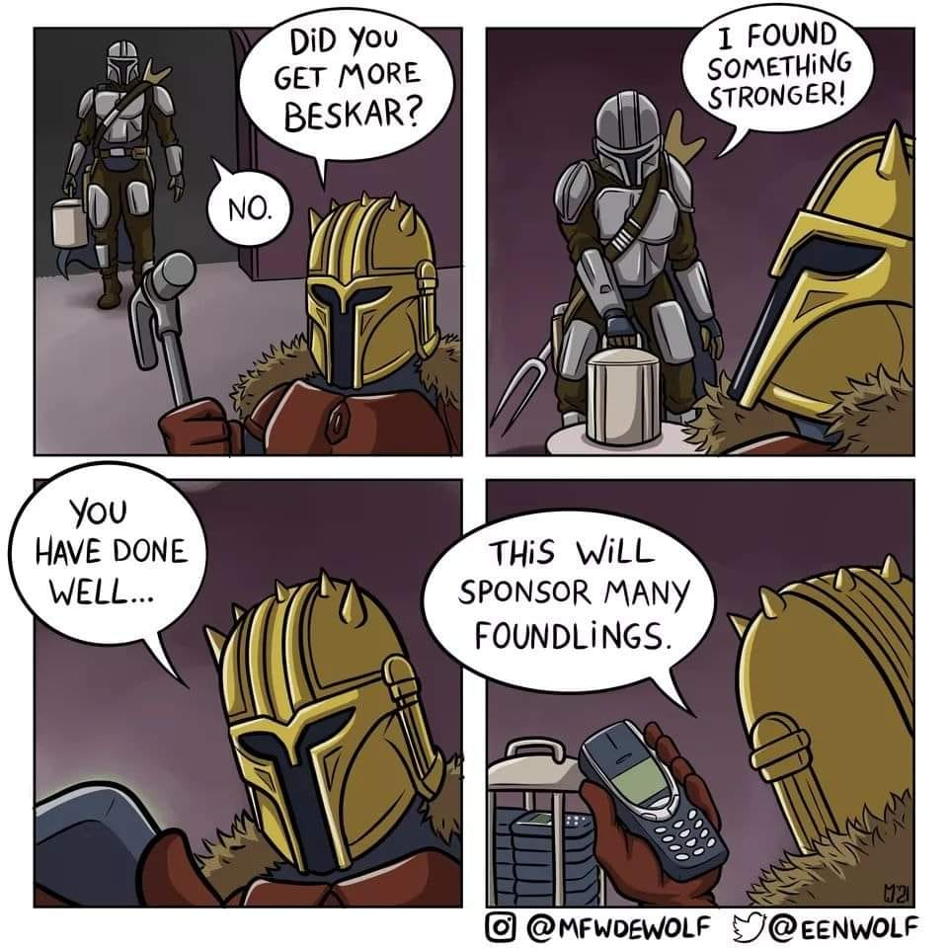
THANK YOU!

